Slide 1
Chapter 1: Introduction

Slide 2
Why use electrical energy?
Electricity delivers energy:
Cleanly
Efficiently
Economically
Flexibly

Slide 3
What is its main drawback?
Storing large amounts of electrical energy is difficult or expensive
Electrical energy must be delivered as a continuous process
Rate of energy delivery i.e., power, is a fundamental concept
Reliable, continuous delivery requires coordinated operation of a set of devices i.e., a power system

Slide 4
What are the attributes of a good power system?
Reliability
Economy
Sustainability
These objectives conflict:
Improving reliability costs money
Cheapest form of electricity generation are not always sustainable

Slide 5
Physical structure of power systems
Multiple sources connected to multiple loads
Enhances reliability
Single failure does not result in a loss of power to the consumers
Improves economy
Aggregating loads reduces the amount of generation capacity needed
Load can be supplied by most economical generation
Supports sustainability
Aggregated wind and solar generation is less variable and more predictable

Slide 6
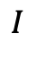
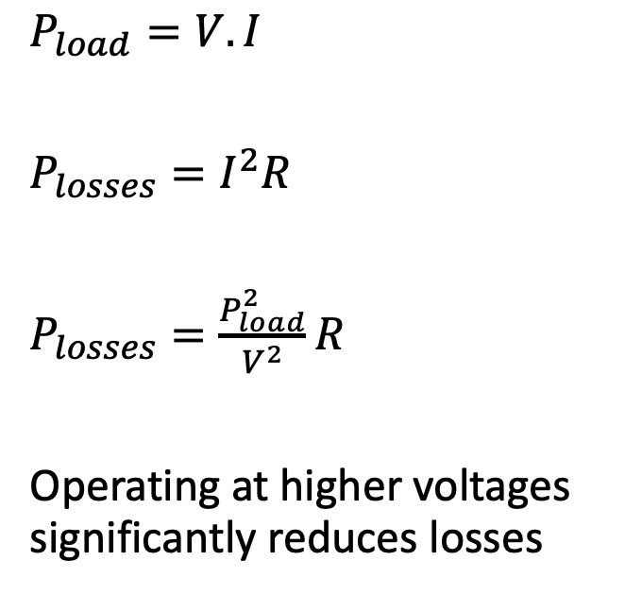
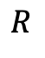
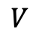
Why ac?
$P_{load}=V.I$
$P_{losses}=I^{2}R$
$P_{losses}=\frac{P_{load}^{2}}{V^{2}}R$
Operating at higher voltages significantly reduces losses
$$R$$
$$I$$
Load
$$V$$

Slide 7
Why ac?
Voltage | Relative Losses
110 V | 1
220 V | 0.25
13 kV | 71.6 10⁻⁶
132 kV | 694.4 10⁻⁹
345 kV | 101.7 10⁻⁹

Slide 8
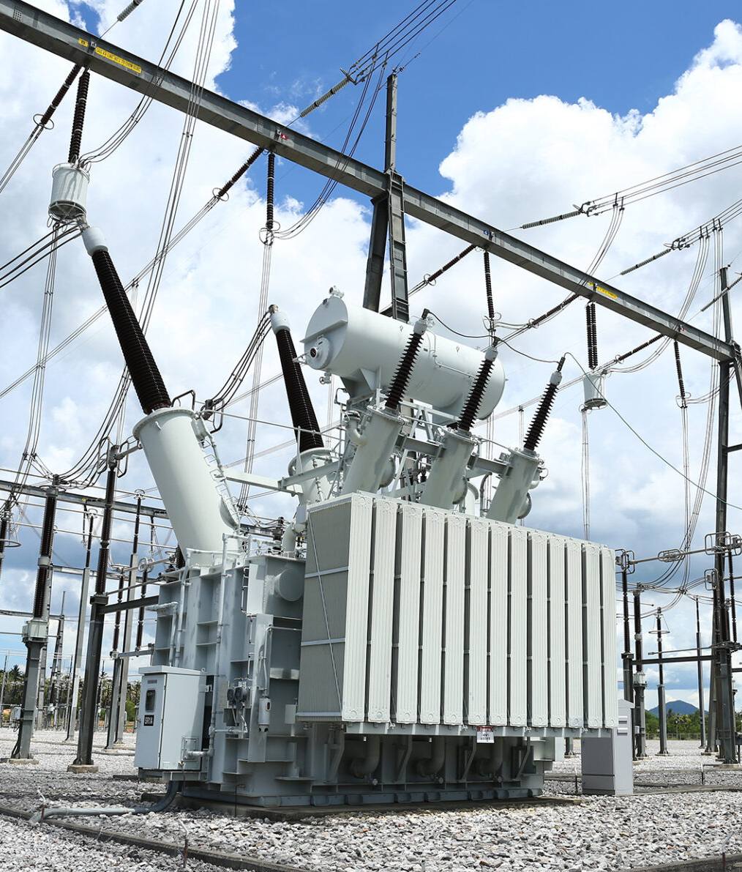
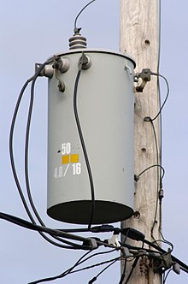
ac transformers
Step-up the voltage
Step-down the voltage
Relatively cheap
Highly reliable
Must balance
Safety
Cost
Practicality
→ Use different voltages at different locations

Slide 9
Typical operating voltages in large power systems
On average, only about 5% of the electrical energy generated in the United States is dissipated as losses in the transmission and distribution networks. Most of these losses occur in the low voltage distribution networks.
Image: United States Department of Energy, Blackout 2003, “Final Report on the August 14, 2003, Blackout in the United States and Canada: Causes and Recommendations”

Slide 10
Typical voltage levels
345 kV
132 kV
30 kV
11 kV
National
transmission
Regional sub-
transmission
Local
distribution
Street-level
distribution
120 V

Slide 11
Typical consumer connections
345 kV
132 kV
30 kV
11 kV
Large
industrial
consumers
Large
commercial
consumers
Industrial
consumers
120 V
Residential and
commercial
consumers

Slide 12
Transmission and distribution networks
Transmission network:
Transmit large amounts of power over long distances
Meshed network
Redundant paths:
Improve reliability
Improve economics
Requires sophisticated protection schemes against faults
Distribution network:
Distribute power to consumers over a limited area
Typically, radial network
Except in some dense urban areas
Lower reliability
Acceptable because faults affect fewer consumers
Radial networks require less sophisticated protection schemes against faults

Slide 13
Centralized and distributed generation
Centralized generation
Conventional generation
Coal plants
Gas plants
Hydro plants
Nuclear plants
Renewable generation
Wind farms
Solar farms
Connected to the transmission network
Distributed generation
Rooftop solar panels
Connected to the distribution network

Slide 14
What about high voltage dc transmission?
Requires power electronics
Convert high voltage ac into high voltage dc at one end of the line
Convert dc back into ac at the other end
These converter stations are very expensive
Justified when:
A lot of power must be transmitted over a long distance
Transmitting this power using ac could create stability problems
Two power systems operating at different frequencies must be connected
A long underground or submarine cable is required

Slide 15






Cyber infrastructure
Control systems
Relays
Meters
Communication networks
Computers
Control centers

Slide 16
Organizational structure
Traditional electric utility
Owns and operates all the generation, transmission, and distribution assets
Has a monopoly for the sale of electricity over its service territory
Vertically integrated monopoly
Investor-owned utilities are regulated by government body
Unbundled competitive market
Generating companies compete to sell electrical energy in open market
Transmission and distribution remain regulated monopolies
System operator is responsible for reliability and efficient operation
In some locations consumers buy electricity from their local distribution utility
On other locations, they have a choice of supplier
More details in Chapter 12

Slide 17
Historical evolution
Originally:
Local generation supplying local consumers
Mostly in urban areas
Economic and reliability benefits
Development of transmission lines connecting remote generation to cities
Interconnections between power systems
1930s: large scale rural electrification
1950s-1960s: development of continent-scale interconnections

Slide 18
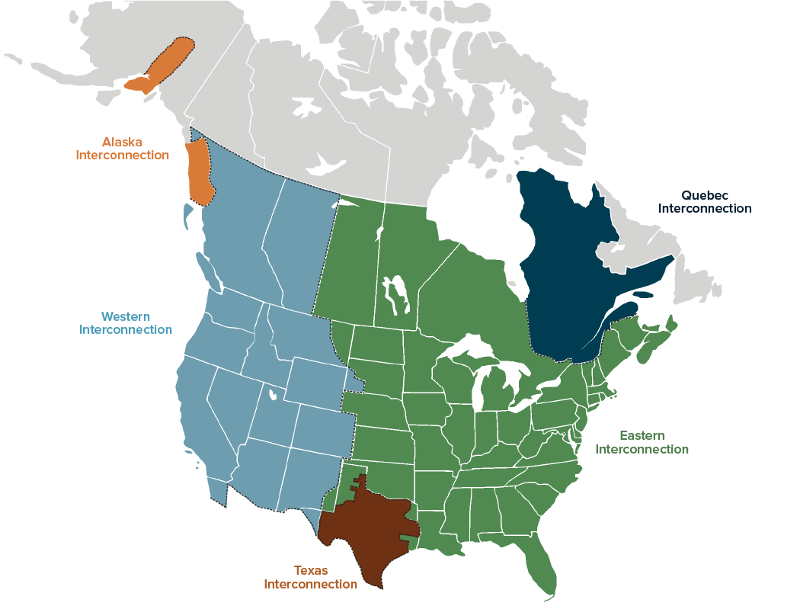
North-American interconnections
Source: Congressional Budget Office

Slide 19
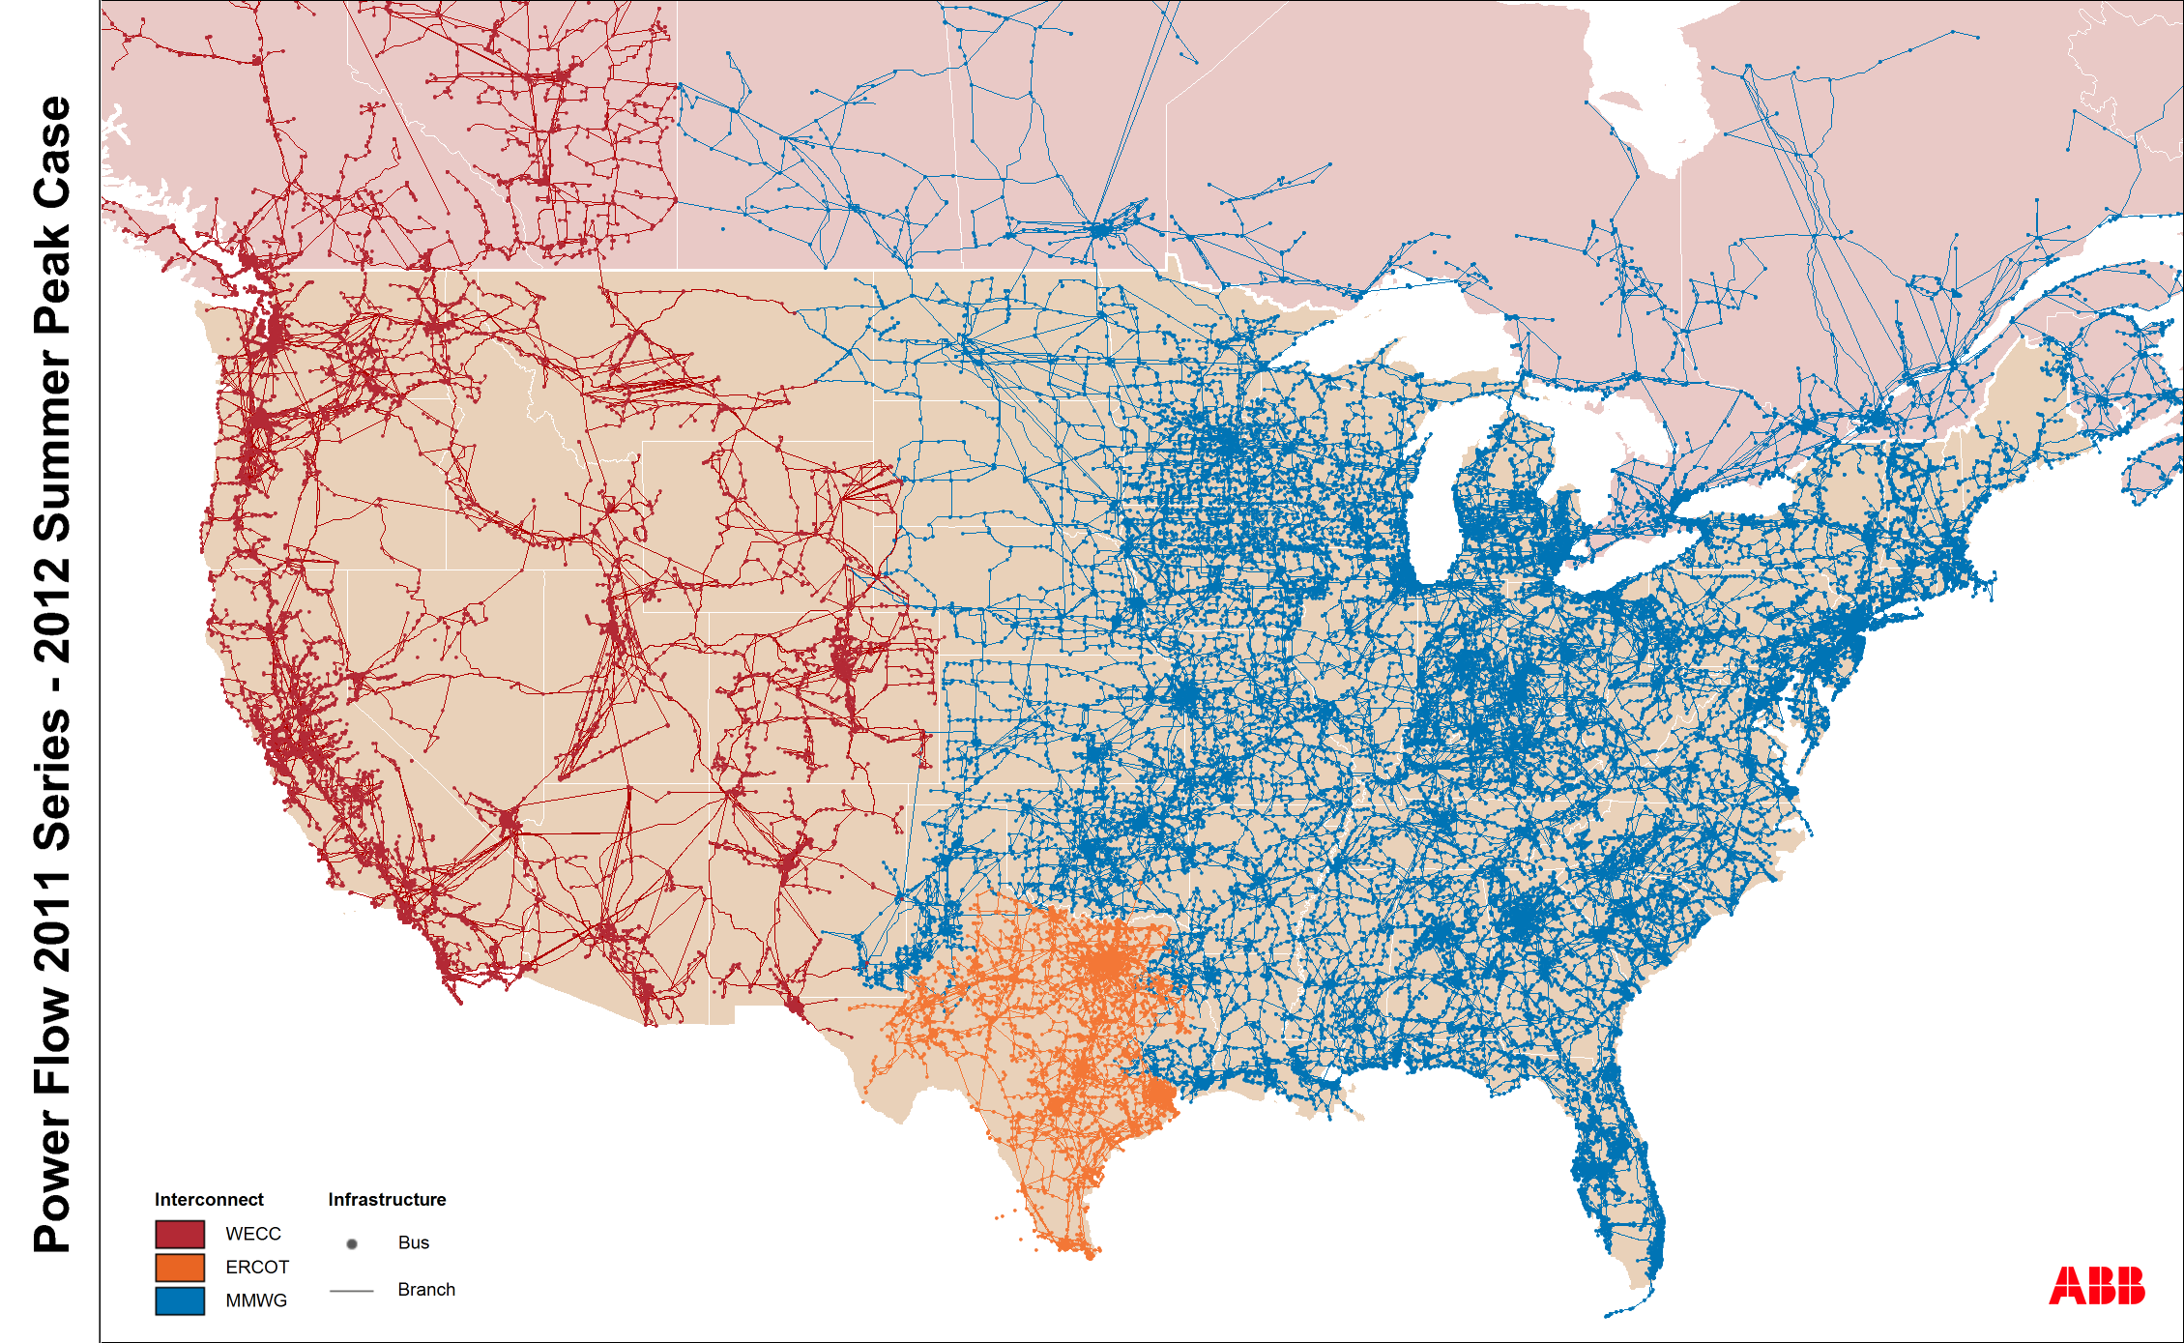
North-American interconnections

Slide 20
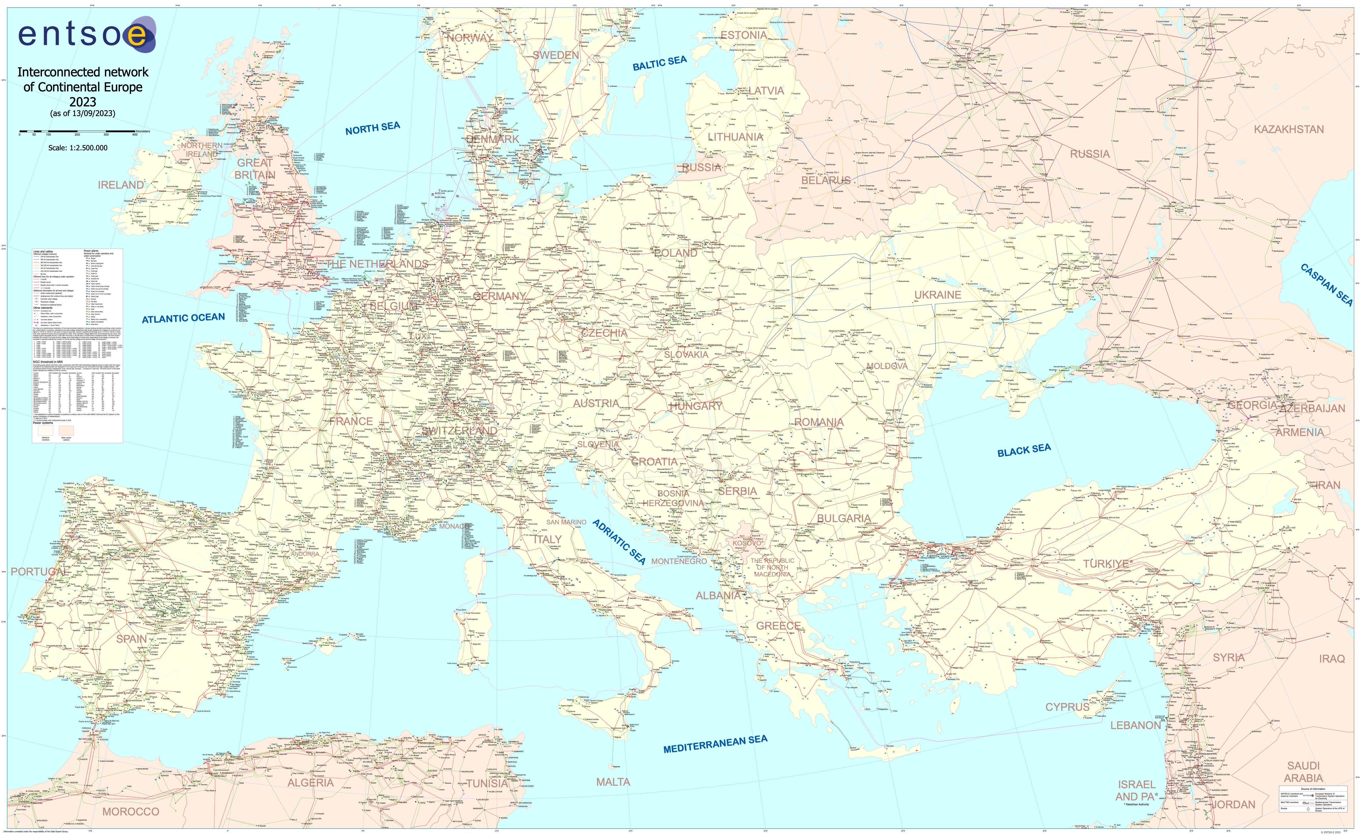
Interconnected network of Continental Europe

Slide 21
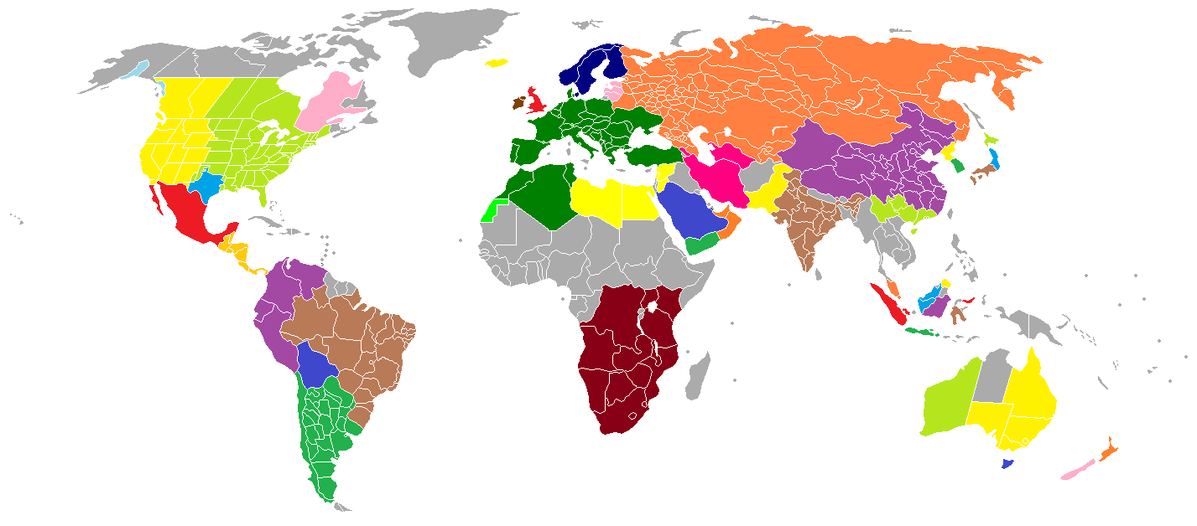
Worldwide interconnections
By Alinor at English Wikipedia, CC BY-SA 3.0, https://commons.wikimedia.org/w/index.php?curid=30154547

Slide 22
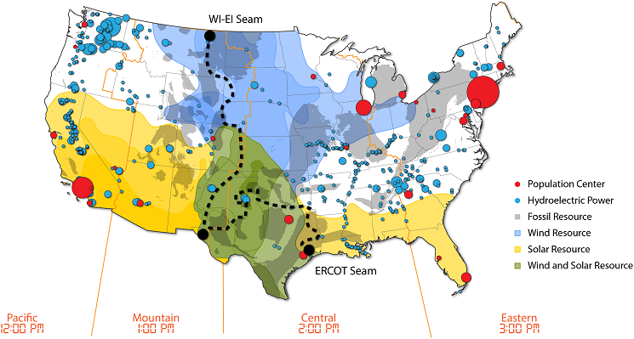
Best renewable resources and largest load centers
Source: NREL

Slide 23
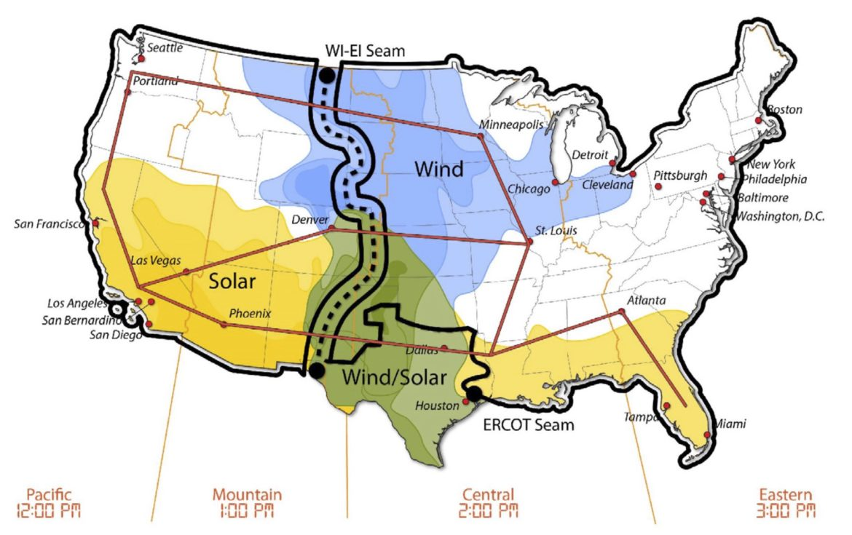
Proposed United States supergrid
Source: NREL

Slide 24
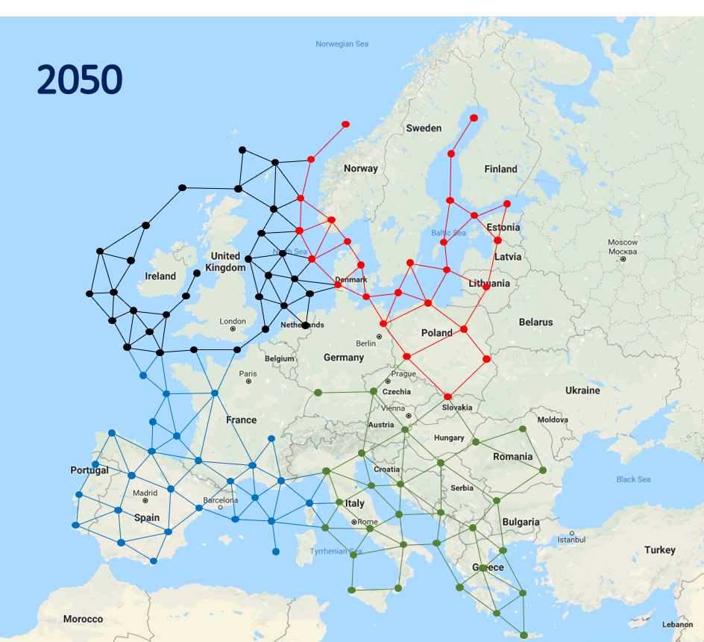
Proposed European supergrid
Emphasis on offshore wind

Slide 25
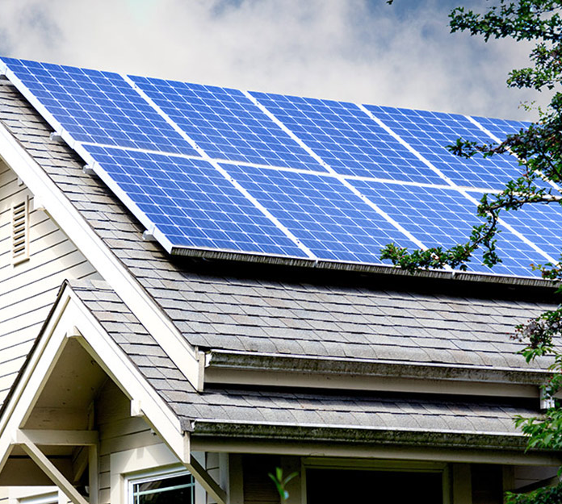
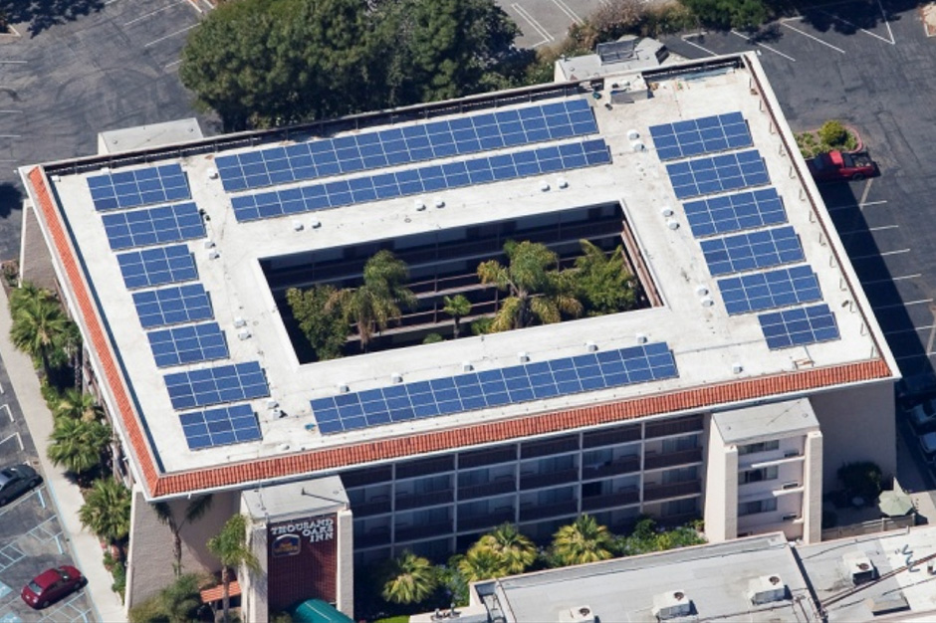
Residential and commercial solar generation
Connected to the distribution network

Slide 26
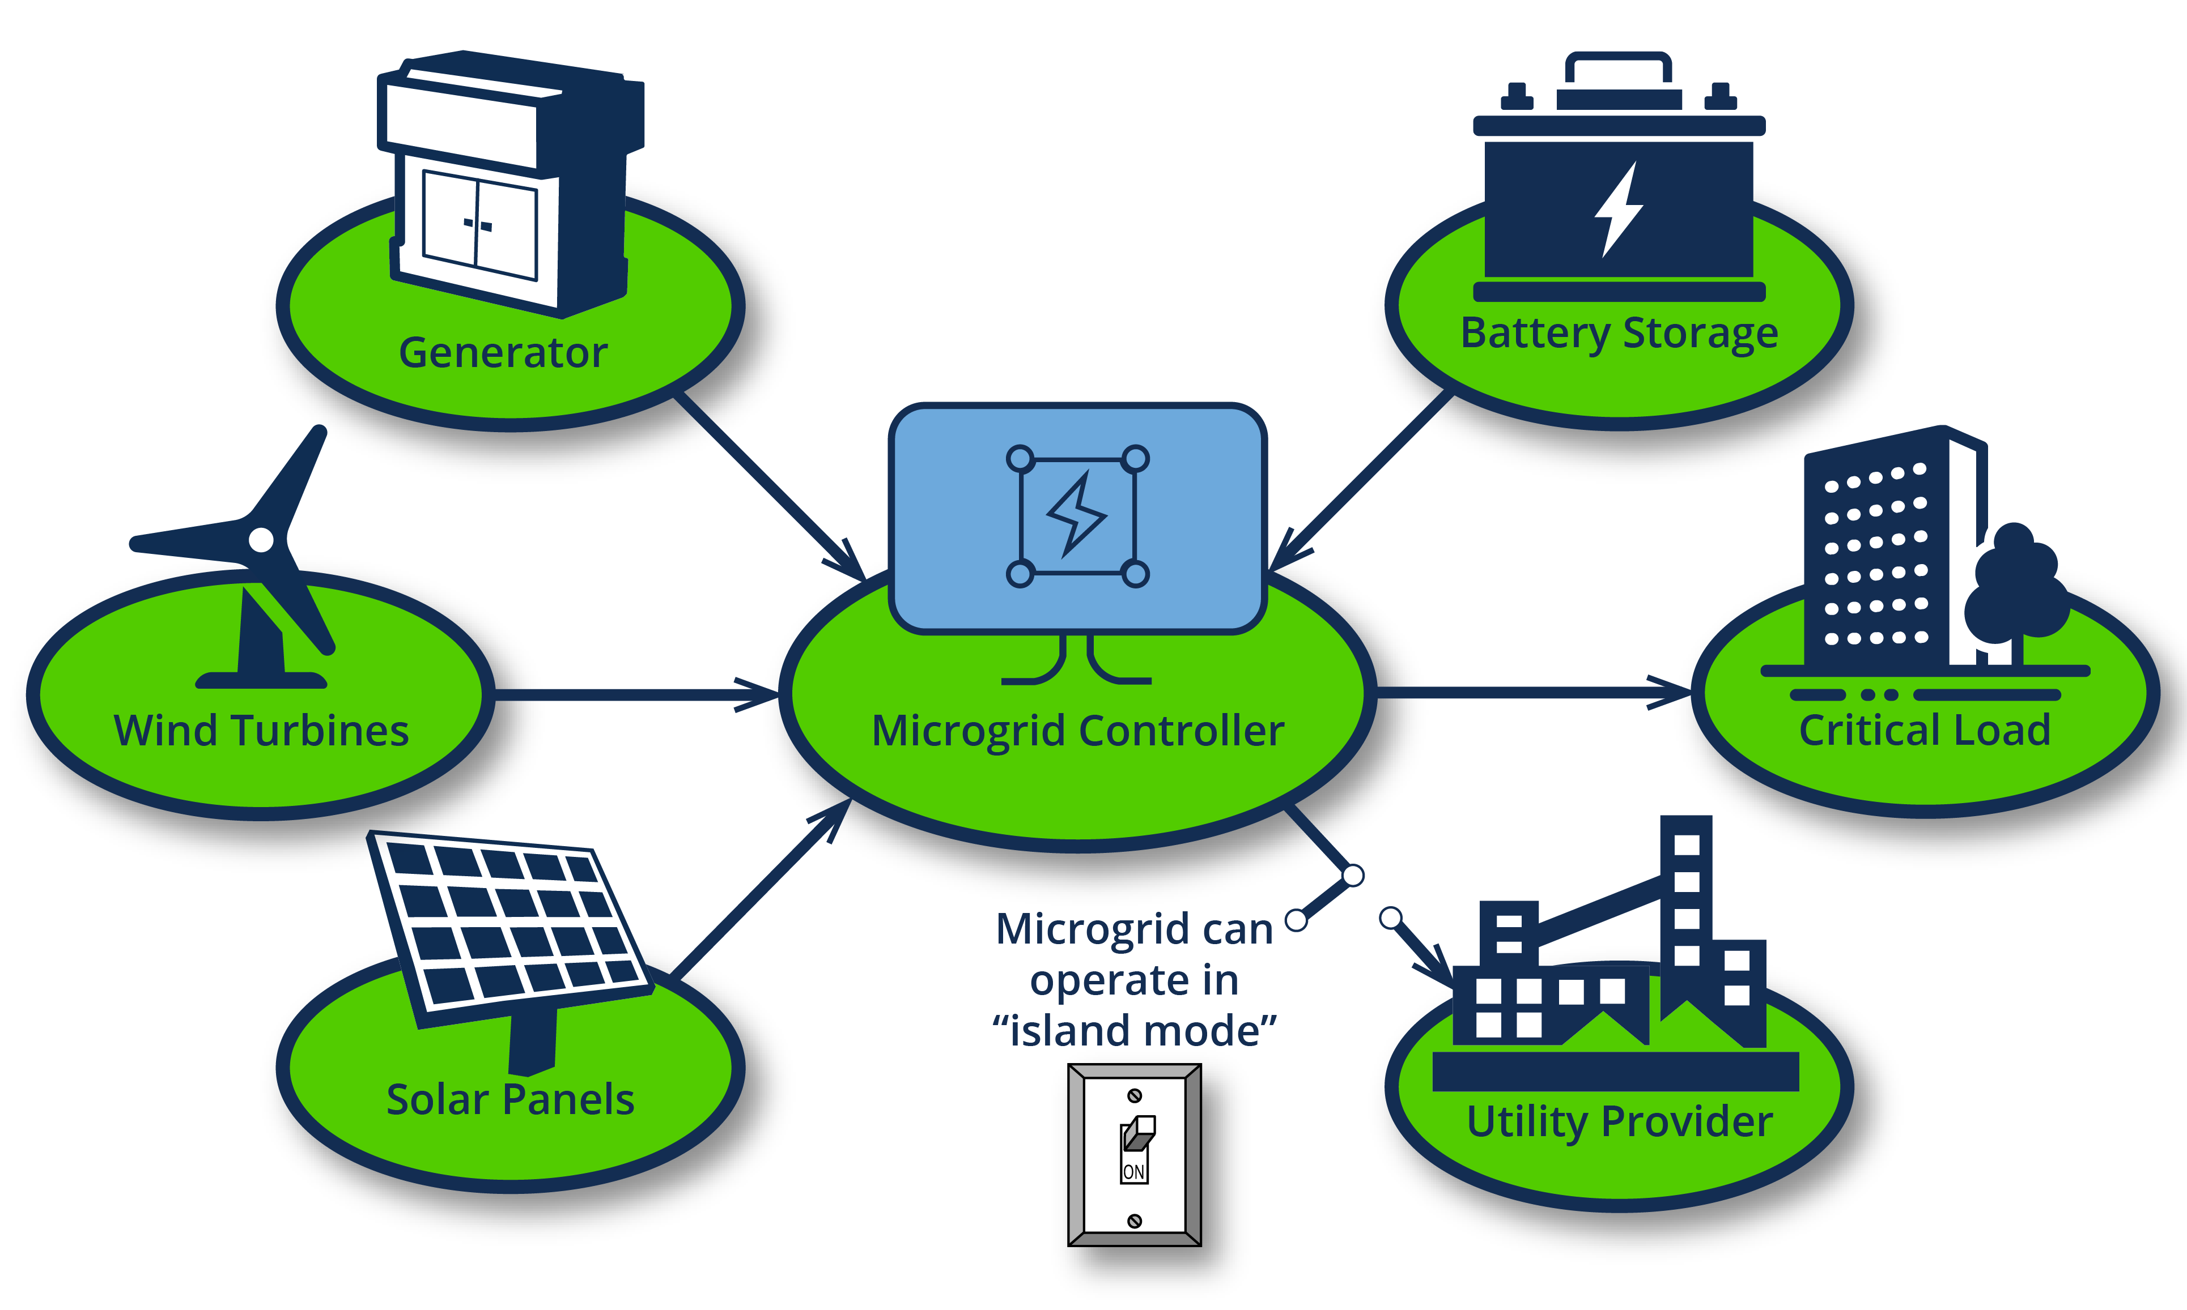
Microgrids
Image: MESA Solutions

